Slide 1
Good Samaritan
Salesforce Guide

Slide 2
Adding Resources
Formerly “Materials Distribution” or “Tier 1”

Slide 3
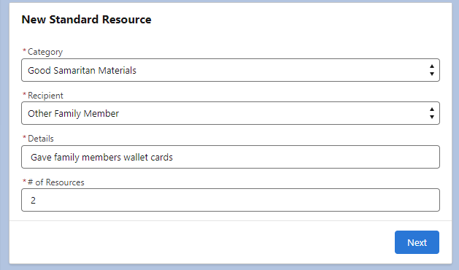
From an Engagement
Use the New Standard Resource component on the right side of the page
Under “Category”, select “Good Samaritan Materials”
Choose the Recipient
Add Details
Indicate # of Resources
Click “Next”

Slide 4
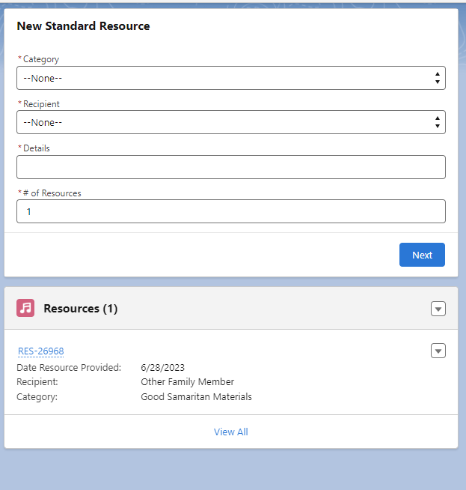
This is now listed as a resource on the Engagement
Notes:
*More recipient options to come*

Slide 5
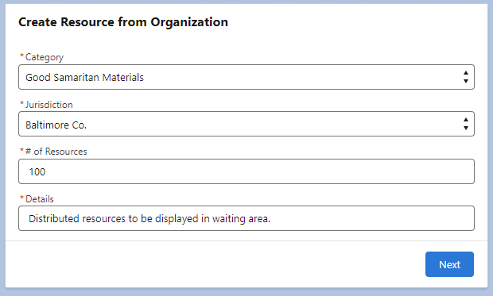
From an Organization Record
Use the “Create Resource from Organization” component on the right side of the page
Under “Category”, select “Good Samaritan Materials”
Then, a field for “Jurisdiction” will appear
Indicate Jurisdiction
Indicate # of Resources
Add Details
Click “Next” and “Finish”

Slide 6
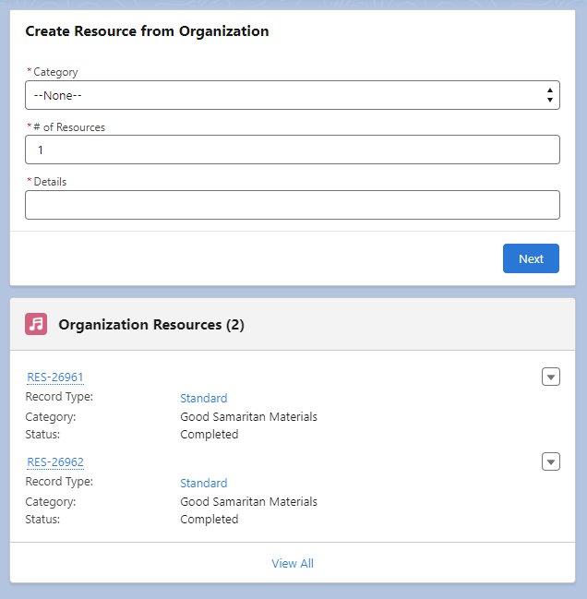
This is now listed as a resource on the Organization Record
Notes:
*More recipient options to come*

Slide 7
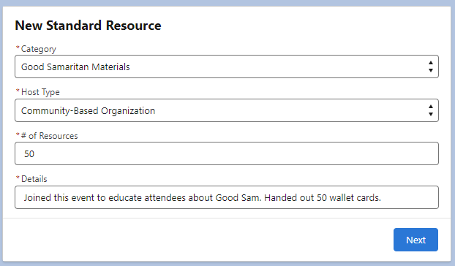
From an MCF Event
Use the New Standard Resource component on the right side of the page
Under “Category”, select “Good Samaritan Materials”
Then, a field for “Host Type” will appear
Indicate Host Type
Indicate # of Resources
Add Details
Click “Next”

Slide 8
Good Samaritan Presentations
Formerly “Tier 2”

Slide 9
Changes to be aware of:
Number of attendees
Audience type
Feedback from attendees (coming soon)

Slide 10
From an Engagement
Click on the “Activity” tab
Click on the “Good Sam Presentation” tab to the right of the “log an Activity” tab
Fill in the fields accordingly

Slide 11
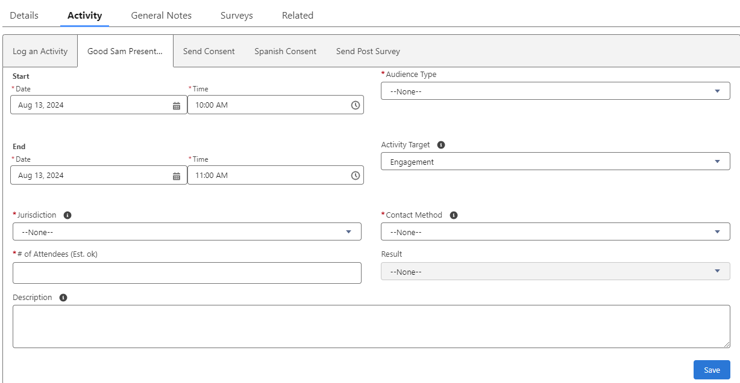

Slide 12
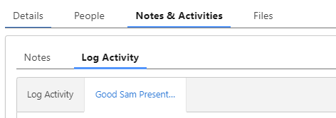
From an Organization Record
Click on “Notes & Activities”, then “Log Activity
Click on the new “Good Sam Presentation” tab
Choose this tab and fill in the fields accordingly
*Note the new fields (host type, jurisdiction of presentation)

Slide 13
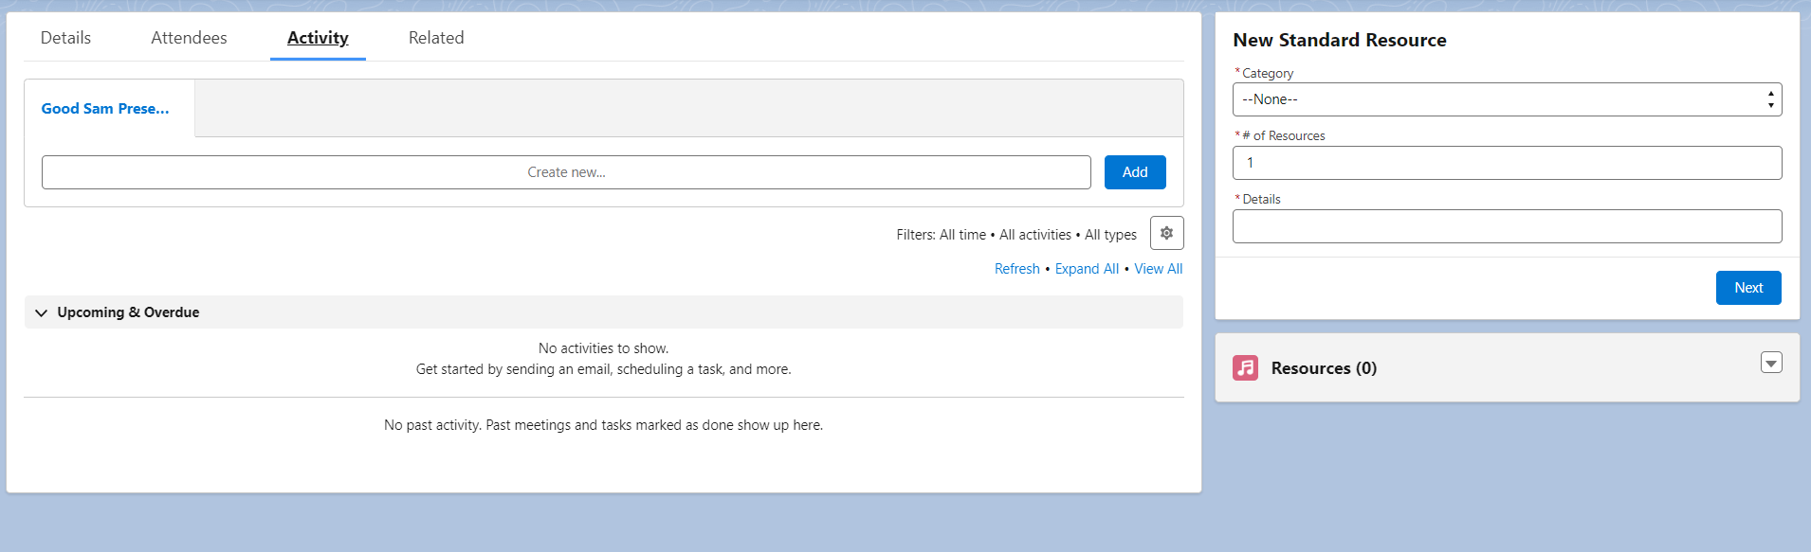
From an MCF Event
(Support groups, workshops, family fun events)
Same process as in an Organization record, but the layout looks like this:

Slide 14
Good Samaritan-Specific Events
Even if the event description indicates that the purpose of the event is to present on the Good Samaritan Law, you still need to log it under the "Good Sam Presentation" tab in the Activity section to ensure it appears correctly in the data.
Thank you!

